Slide 1
VIRAL HAEMORRHAGIC FEVERS
Presenters: Dr. Elizabeth Danstan
Dr. Silas Gamba
Facilitator: Dr. Joan Rugemalila

Slide 2
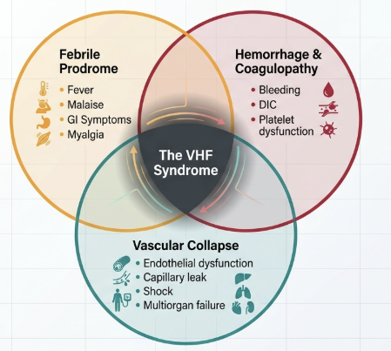
INTRODUCTION
VHF are defined by febrile illnesses, abnormal vascular regulation & damage
  Early ~ mild hypotension, flushing & conjunctival vasodilation.
  Progress to shock ~ capillary leakage, effusions
Haemorrhage is not a universal feature.
Commonest with CCHF less with Lassa fever.
Paessler, S. and Walker, D.H., 2013. Pathogenesis of the viral hemorrhagic fevers. Annual Review of Pathology: Mechanisms of Disease, 8, pp.411–440. https://doi.org/10.1146/annurev-pathol-020712-164041.

Slide 3
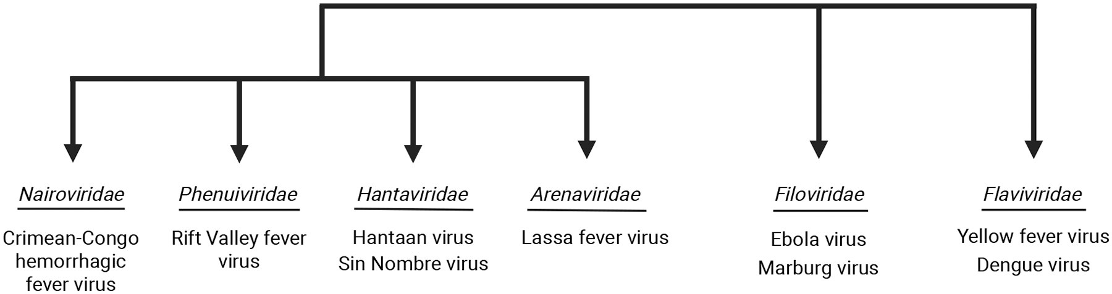
ETIOLOGY
23 agents, enveloped RNA viruses but distinct genetic lineage.
These variation dictates cell tropism, replication, and clinical manifestations.
Paessler, S. and Walker, D.H., 2013. Pathogenesis of the viral hemorrhagic fevers. Annual Review of Pathology: Mechanisms of Disease, 8, pp.411–440. https://doi.org/10.1146/annurev-pathol-020712-164041.
Notes:
Arenaviridae (Old & New World): Enveloped, bisegmented negative-strand RNA viruses using an ambisense coding strategy. Key members include Lassa virus (Old World) and Junín/Machupo (New World)
Filoviridae: Negative-sense, nonsegmented linear RNA. Characteristic filament structure (80 nm diameter, up to 1100 nm length). Includes Ebolavirus (5 species) and Marburgvirus
Flaviviridae: Small (40–65 nm), spherical, positive-sense RNA viruses. Encodes a single polyprotein cleaved into three structural and seven nonstructural (NS) proteins.
Bunyavirales (Nairoviridae & Phenuiviridae): Large group including CCHF (tick-borne) and Rift Valley Fever (mosquito-borne/livestock contact)

Slide 4
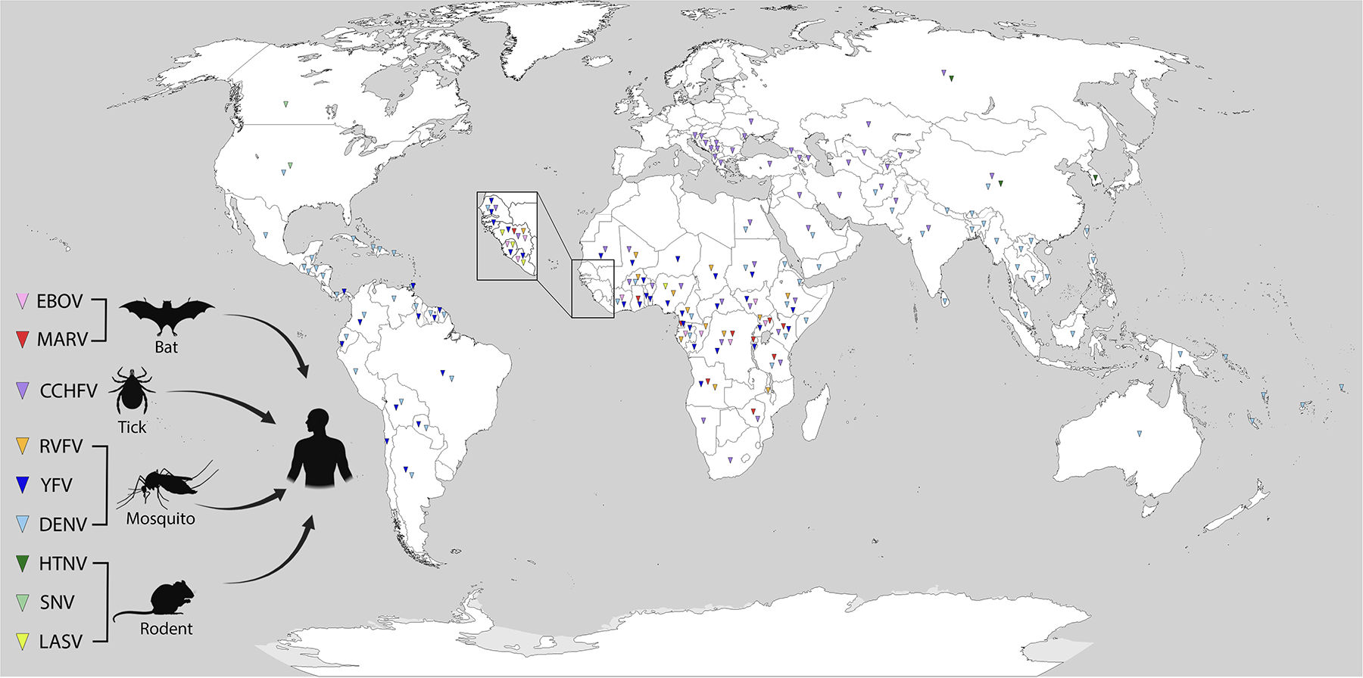
EPIDEMIOLOGY
Filoviruses (Ebola, Marburg): SSA; sporadic zoonotic outbreaks
Arenaviruses: Lassa → W. Africa
Flaviviruses:
  Dengue → global tropics/subtropics
  Yellow fever → tropical Africa & South America
Bunyavirales:
  CCHF → Africa, Middle East, SE Europe
  RVF → Africa & Arabian Peninsula
Fig. Geographic distribution of haemorrhagic fever viruses
Perkins, M.V. and Mackman, N., 2026. Potential mechanisms underlying bleeding during infection with hemorrhagic fever viruses. Arteriosclerosis, Thrombosis, and Vascular Biology, 46(2), e323625. https://doi.org/10.1161/ATVBAHA.125.323625.
Notes:
Bats as Key Reservoirs: Fruit bats (specifically Rousettus aegyptiacus for Marburg) are the recognized or suspected reservoirs for filoviruses
Rodent-Borne Cycles: Arenaviruses and Hantaviruses are maintained in chronic, often asymptomatic, infections in specific rodent hosts, such as the multimammate rat (Mastomys natalensis) for Lassa and the vesper mouse (Calomys musculinus) for Junín virus.
Arthropod Vectors:
Ticks: Hyalomma species are both the reservoir and primary vector for CCHF.
Mosquitoes: Aedes aegypti and Aedes albopictus are the primary vectors for DENV and YFV. RVFV is maintained in Aedes eggs via transovarian transmission and amplified in livestock during heavy rainfall.
Transmission Dynamics
Zoonotic Spillover: Human infection typically occurs through direct contact with infected animal tissues, blood, or excreta (e.g., butchering livestock for RVF/CCHF, or inhaling aerosolized rodent urine for Lassa/Hantaviruses).
Human-to-Human Transmission: This is a hallmark of Filoviruses, CCHF, and Arenaviruses (specifically Lassa and Machupo). It occurs through direct contact with blood, secretions, or organs of infected individuals, often exacerbated by inadequate infection control in healthcare settings.
Occupational Risk: Adult male agricultural workers are at highest risk for New World arenaviruses due to exposure during harvest seasons

Slide 5
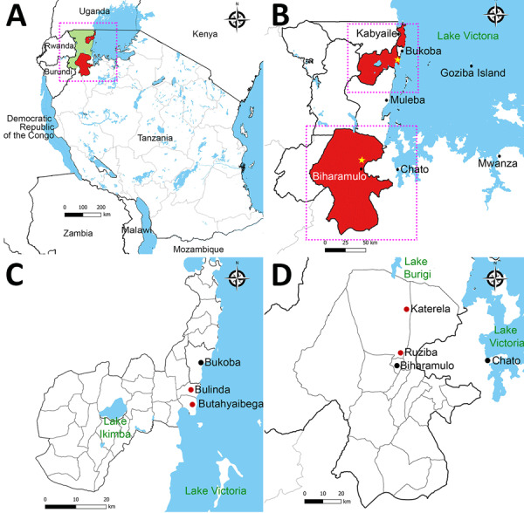
contd.
Tanzania reported Marburg outbreaks in 2023 and 2025 in Kagera region
Across both, 174 suspected cases were investigated
Only 10 were confirmed infections but six deaths; case fatality rate: 66.7%
Genomic analysis showed relation to Rwanda 2024 and Uganda 2014 strains
Mapunda, L.A. et al., 2026. Genomic insights into Marburg virus strains from 2023 and 2025 outbreaks in Kagera, Tanzania. Emerging Infectious Diseases, 32(1), pp.55–62. https://doi.org/10.3201/eid3201.251314
Haque, H. et al., 2026. Infectious disease response in Tanzania: Enhanced strategies from the 2023 to 2025 Marburg outbreaks. Public Health Challenges, 5, e70266. https://doi.org/10.1002/puh2.70266. PMC13130137.

Slide 6
contd.
Study by Shao et al. (2012–2014, n=735 febrile pts) confirmed Crimean-Congo hemorrhagic fever exposure in north Tanzania
  1.8% IgG confirmed seropositivity
  was associated with livestock contact (aOR 12.6, 95% CI 1.6–99.8)
Major dengue outbreaks have also been reported, e.g., in 2019 there were 6,795 cases confirmed cases
Belau, M.H. et al., 2025. Integrated rapid risk assessment for dengue fever in settings with limited diagnostic capacity and uncertain exposure: Development of a methodological framework for Tanzania. PLoS Neglected Tropical Diseases, 19(3), e0012946. https://doi.org/10.1371/journal.pntd.0012946
Shao, E.R. et al., 2025. Seroprevalence and risk factors for Crimean-Congo hemorrhagic fever virus exposure among febrile patients in northern Tanzania. Tropical Medicine & International Health, 30(3), pp.193–200.

Slide 7
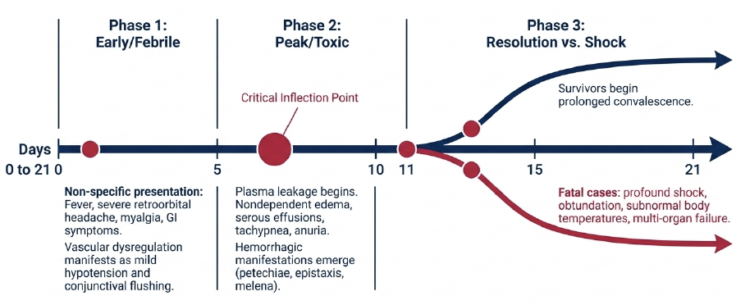
CLINICAL PROGRESSION
incubation
Slobodan Paessler, David H. Walker. Pathogenesis of the viral hemorrhagic fevers. Annual Review of Pathology: Mechanisms of Disease. 2013;8:411–440. doi:10.1146/annurev-pathol-020712-164041
Notes:
1. Incubation phase (2–21 days depending on virus)
Clinical: Asymptomatic
Pathobiology:
Viral entry via skin (bites, needles, mucosa, aerosols depending on virus)
Early replication in dendritic cells and macrophages
Spread to regional lymph nodes → primary viremia
Innate immune evasion begins (interferon antagonism in filoviruses, e.g., Ebola/Marburg)
2. Early febrile phase (viremic phase)
Clinical: High fever, headache, myalgia, malaise, nausea
Pathobiology:
High-level viremia with systemic dissemination
Infection of monocytes/macrophages → cytokine release (TNF-α, IL-6, IL-1β)
Endothelial activation begins (not direct destruction in most VHFs)
Initial thrombocytopenia due to platelet consumption + bone marrow suppression
“Flu-like” presentation driven by cytokine storm
3. Systemic vascular phase (critical transition phase)
Clinical: Vomiting, diarrhea, hypotension, confusion
Pathobiology:
Widespread infection of mononuclear phagocyte system
Massive cytokine storm → endothelial dysfunction
Increased vascular permeability (VEGF, TNF-mediated)
Coagulation cascade activation → early disseminated intravascular coagulation (DIC)
Hepatic injury → reduced clotting factor synthesis
Lymphocyte apoptosis (especially in Ebola/Marburg)
4. Hemorrhagic phase (not universal, severity-dependent)
Clinical: Petechiae, mucosal bleeding, GI bleed, hematuria
Pathobiology:
Platelet dysfunction + thrombocytopenia
Consumption coagulopathy (DIC)
Endothelial barrier breakdown → plasma + RBC leakage
Viral proteins disrupt coagulation pathways (e.g., tissue factor upregulation in Ebola)
NOT purely “vessel rupture”—functional vascular failure dominates
5. Shock / multiorgan failure phase
Clinical: Hypotension, renal failure, hepatic failure, encephalopathy
Pathobiology:
Capillary leak → intravascular volume depletion
Myocardial depression from cytokines
Acute tubular necrosis from hypoperfusion
Severe hepatocellular necrosis → coagulopathy worsens
Metabolic acidosis + lactate accumulation
Terminal immunoparalysis in some cases
6. Convalescent phase (survivors)
Clinical: Prolonged fatigue, weakness, arthralgia
Pathobiology:
Immune recovery after viral clearance
Tissue repair after endothelial and hepatic injury
Persistent antigen/virus possible in immune-privileged sites (Ebola: eye, testes)
Post-viral inflammatory syndrome

Slide 8
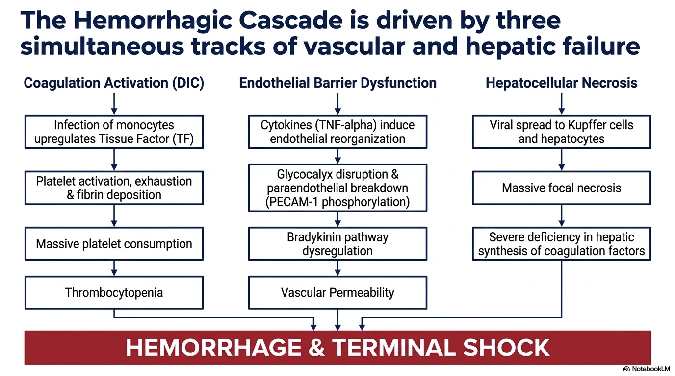
HEMORRHAGIC CASCADE
Megan V. Perkins, Nigel Mackman. Potential mechanisms underlying bleeding during infection with hemorrhagic fever viruses. Arteriosclerosis, Thrombosis, and Vascular Biology. 2026;46(2):e323625. doi:10.1161/ATVBAHA.125.323625

Slide 9
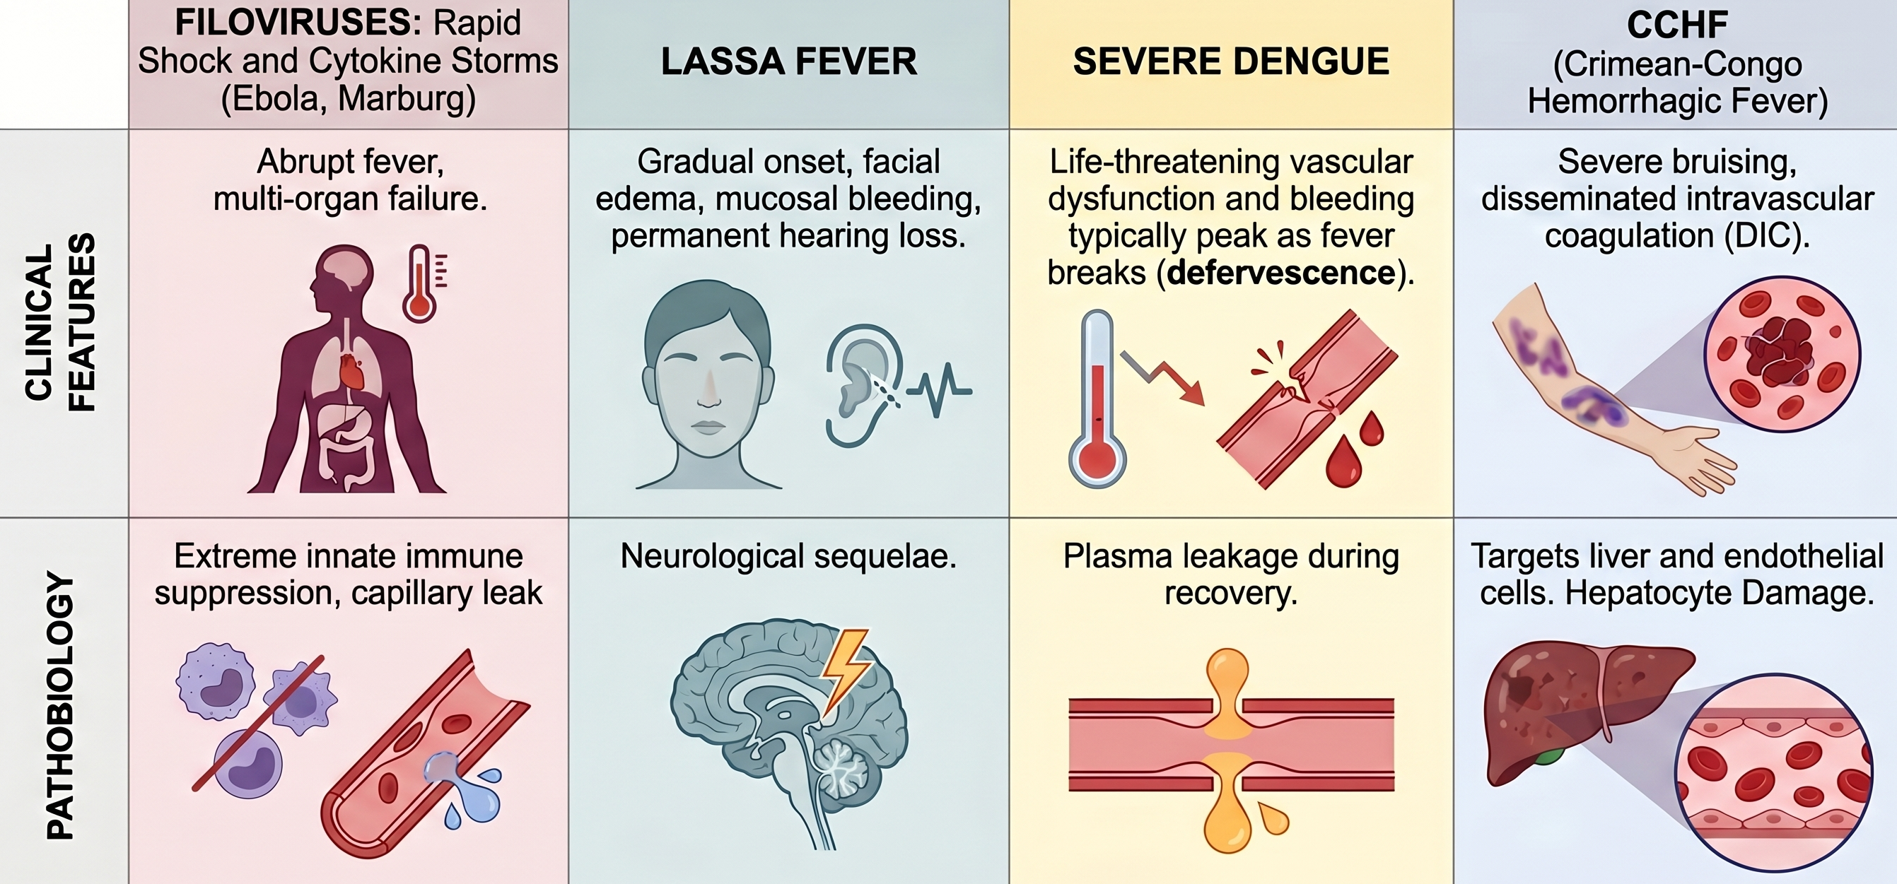
DIFFERENTIAL APPROACH

Slide 10
DIAGNOSTIC MODALITIES
Culture requires BSL-3/4 RT-PCR
RT-PCR is gold standard first line test in acute/viremic phase
  On inactivated samples can be performed at BSL-2, broadening access
Serology is reserved for later illness or convalescent confirmation
  Negative antibody during second week does not exclude diagnosis
Multiplex RT-PCR: can simultaneously detect EBOV, MARV, LASV, CCHFV, RVFV, DENV, and YFV
Plasma/blood if alive or oropharyngeal swabs if dead
Megan V. Perkins, Nigel Mackman. Potential mechanisms underlying bleeding during infection with hemorrhagic fever viruses. Arteriosclerosis, Thrombosis, and Vascular Biology. 2026;46(2):e323625. doi:10.1161/ATVBAHA.125.323625
Notes:
Dry blood swabs may be used but may lead to a significant loss of sensitivity.
The preferred swab type is nylon flocked swabs.
Swabbing of the nasopharynx is not recommended as the likelihood of detecting virus is not well understood.
Dry swabs may be used if the lab is equipped to resuspend them in nuclease-free water.
Serology: Identify previous exposure - asymptomatic or convalescent individual who may have been
Pan-filovirus NAAT To confirm if the infection is caused by a filovirus affecting humans (Orthoebolavirus or Orthomarburgvirus
v

Slide 11
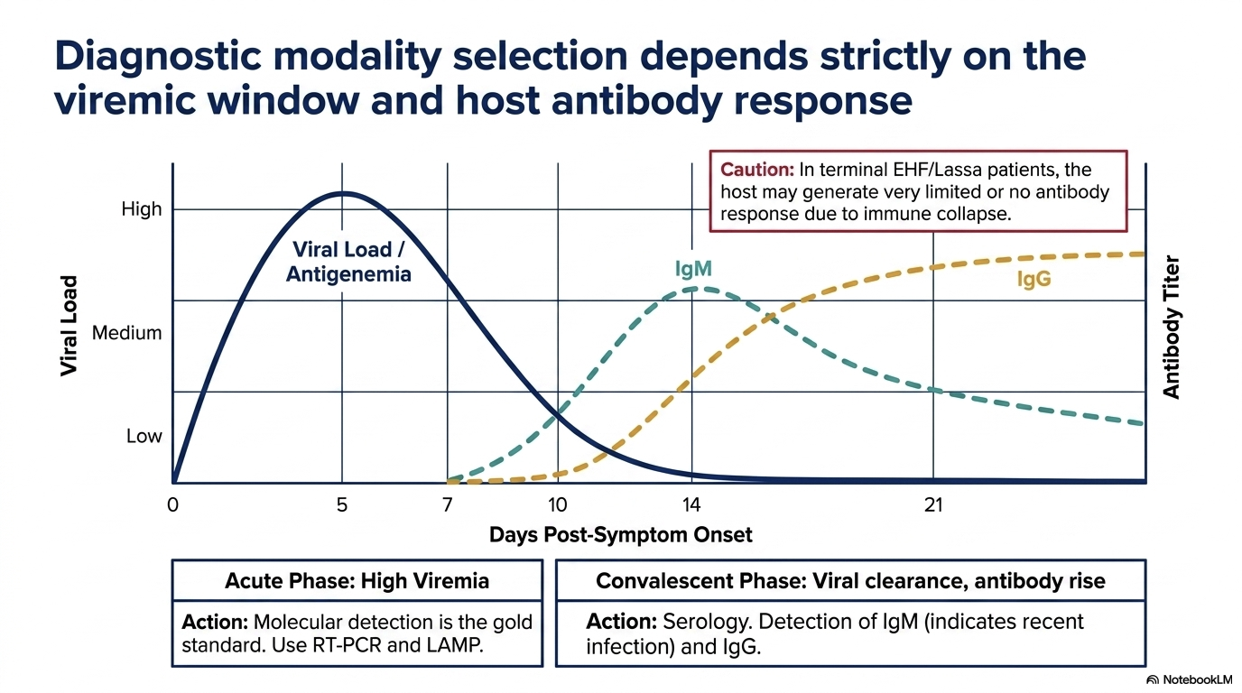
DIAGNOSTIC MODALITIES

Slide 12
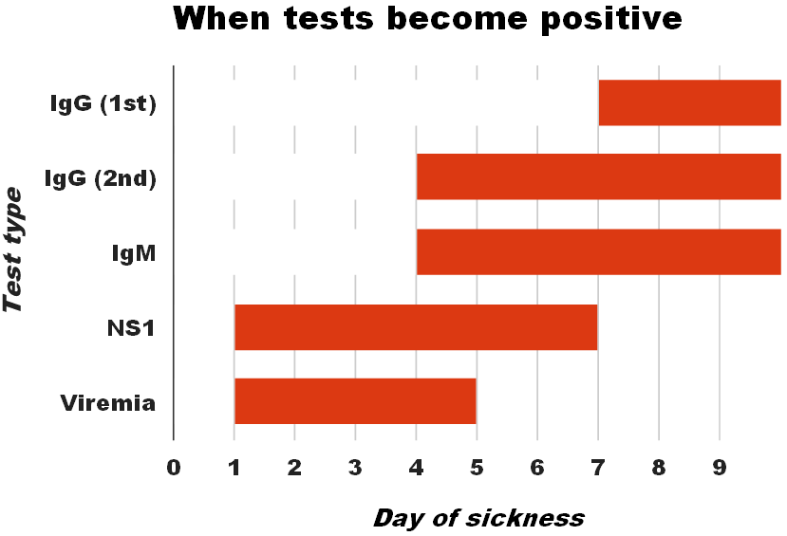
..contd
Dengue often misdiagnosed as malaria.
Diagnosis is mainly outbreak-driven (PCR/NS1), not routine.

Slide 13
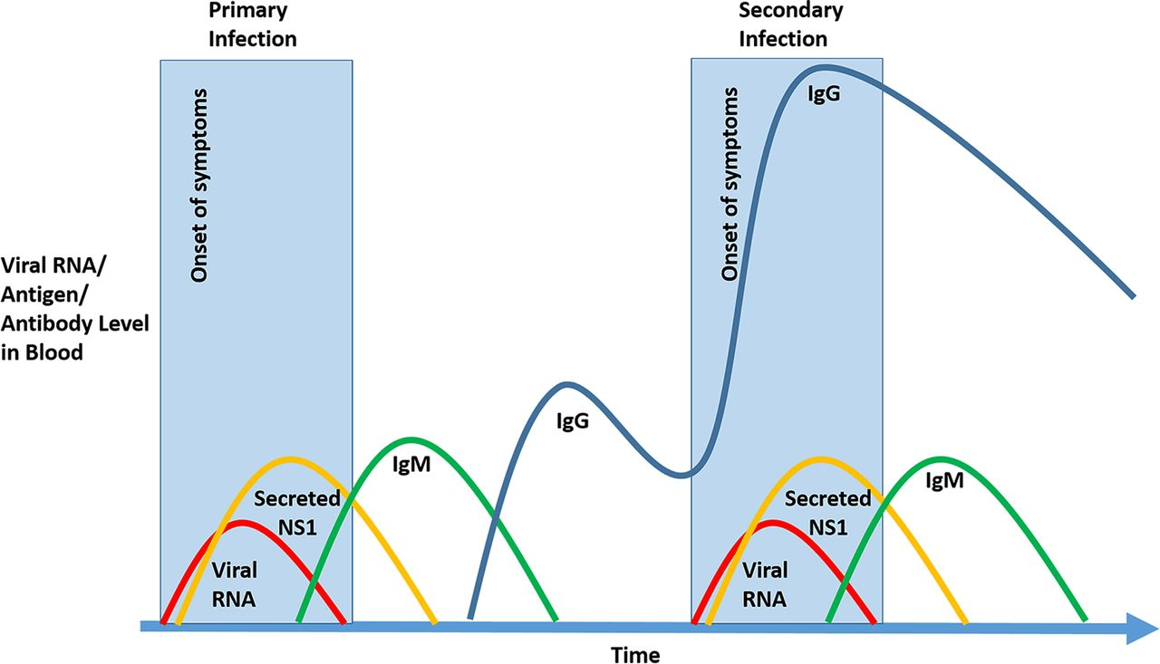
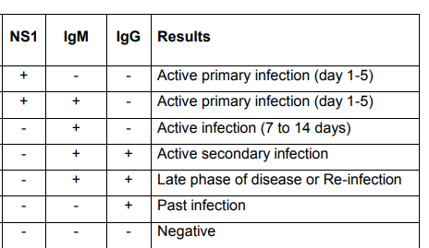
DENGUE DIAGNOSTICS
IgM/IgG antibody ratios is used to distinguish primary and secondary dengue infections
antibody-dependent enhancement → cytokine storm → endothelial junction disruption → capillary leak syndrome
Notes:
Simple rapid tests for NS1/IgM/IgG
Most facilities
All positive for NS1/IgM/IgG sent to NHLQATC
Serotyping
quality check
Genotyping
Sequencing
Quantitative method (ELISA) for IgG IgM and NS1
Molecular Test Polymerase Chain Reaction - PCR
Many types of rapid tests from different manufacturers
Some rapid test used not evaluated in country
Accessibility of quantitative and more specific methods
Interpretations of results
NS1 drops from day 4 of illness
IgM/IgG higher yield later in the convalescent phase
Low levels/absence of detectable IgM in some secondary infections
Cross-reaction with other flaviviruses
Difficult to interpret - presumed positive, equivocal, or inconclusive tests
*Jorge O Pozo-Aguilar Evaluation of host and viral factors associated with severe dengue based on the 2009 WHO classification

Slide 14
…contd
↓WBC < 5,000/µL: bone marrow suppression by dengue virus
↓Platelets < 100,000/µL (severe < 50,000/µL): immune destruction + marrow suppression + consumption
↑Hematocrit ≥ 5-10% rise from baseline (warning sign): plasma leakage due to endothelial dysfunction
↑AST > 2× ALT (often AST > 200 IU/L): muscle + hepatic injury from systemic viral inflammation

Slide 15
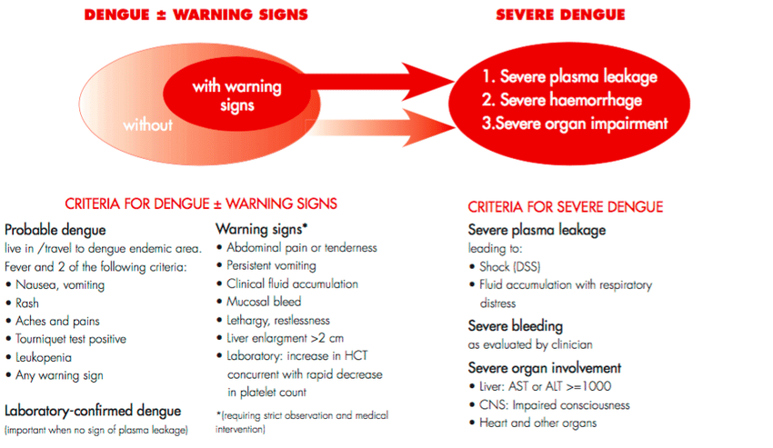
…contd
WHO Classification:
Classic dengue fever
Dengue Hemorrhagic fever
Dengue shock syndrome

Slide 16
MANAGEMENT PRINCIPLES
Strict Infection prevention and control
Immediate patient isolation, full barrier precautions, PPE, and infection prevention to stop nosocomial transmission
Early diagnosis and public response: Rapid testing, contact tracing, surveillance, and safe burial practices
Identification of patients at high risk for complications
  Low SBP, AMS, Tachypnoea, Hypoxia, Haemorrhagic manifestations etc
Early optimized supportive care
  Prompt management of shock, oxygenation, electrolyte correction, and organ support in high-dependency/ICU settings

Slide 17
..contd
Complications of VHD include:
Seizure
Encephalopathy
Haemorrhage
  haematemesis
  haematochezia
  vaginal bleeding
  gingival bleeding
  intracerebral haemorrhage
Acute renal failure/kidney injury
Metabolic acidosis
Hypoxic respiratory failure
Sepsis and septic shock.

Slide 18
...contd
Careful fluid resuscitation to avoid worsening capillary leak (pulmonary edema & third spacing)
  Fluid input and output should be monitored by recording
Symptomatic and complication management
  Antipyretics (avoid NSAIDs), antiemetics, management of bleeding, and treatment of secondary infections

Slide 19
FLUID RESUSCITATION
Use isotonic crystalloid fluid; 0.9% saline or Ringer’s lactate.
Bolus up to 30 ml/kg or until normalization of signs of perfusion
If shock persists, then add vasopressors to maintain perfusion
  For adults, noradrenaline is 1st line: 0.1 mcg/kg/min, max 0.75
If overload develop, fluids should be stopped until signs resolve.
Notes:
Treatment of patient with some dehydration using oral rehydration salts (ORS)
WHO ORS contain: glucose 13.5 g/l, sodium chloride 2.6 g/l, potassium chloride 1.5 g/l, trisodium citrate dihydrate 2.9 g/l, (total osmolarity of 245 mOsm/l).
For adult patients unable to drink sufficient volumes of liquids to maintain hydration status, it is recommended to give IV fluids.
• In adults, it is recommended to alternate between 0.9% saline and Ringer’s lactate.
• In children, use Ringer’s lactate if available but monitor the serum electrolytes regularly.

Slide 20
BLOOD PRODUCTS
If haemorrhaging, ensure two large bore IV cannulae. Measure Hb, platelets and coagulation cascade
Consider PRBC transfusion if active bleeding and haemodynamic instability or Hb < 7 g/dl
Fresh plasma to target INR < 1.5, and platelets to target > 50
Consider IV tranexamic acid: 1gm 8hrly and IV vitamin K 5-10mg

Slide 21
SYMPTOMS MANAGEMENT
Analgesics (eg, paracetamol and opioids) are recommended
  Nonsteroidal anti-inflammatory drugs (NSAIDs) should be AVOIDED given their effects on platelet function and risk of gastritis
Nausea/vomiting : Ondansetron, PPIs for gastritis
Diarrhoea should be managed conservatively.
  The use of anti-motility agents is not generally recommended given the potential for paralytic ileus.

Slide 22
THERAUPETICS
Lassa fever: No approved antiviral; ribavirin used early off-label with limited evidence of benefit
CCHF: No approved treatment; ribavirin sometimes used but efficacy remains uncertain
Marburg & Dengue: No approved antivirals; management is strictly supportive care per WHO guidelines

Slide 23

THERAUPETICS FOR EVD
Ebola virus disease: Only VHF with approved targeted therapy
WHO recommend either mAb114 (Ebanga) or REGN-EB3(Enzameb) for:
  RT-PCR confirmed EVD
  Neonates of unconfirmed EVD status, 7 days or younger, born to mothers with confirmed EVD

Slide 24
PALM STUDY
Design: RCT, 2018–2020 Ebola outbreak in DRC
Interventions: standard care vs 3 mAbs (including REGN-EB3 & mAb114 , ) and antivirals. Early trial termination due to benefit.
Outcomes:
  Mortality reduced ~34% (REGN-EB3); p = 0.002 and ~35% (mAb114); p = 0.035 vs higher mortality in control (>50%)
Impact: Established monoclonal antibody therapy as standard of care for Ebola virus disease
Notes:
Result: REGN-EB3 and mAb114 significantly reduced mortality compared with ZMapp and remdesivir, leading to this recommendation
Prevail trial: tested Zmapp (a triple monoclonal antibody) vs standard care in March – Nov 2025

Slide 25
Remdesivir Use
Treatment with remdesivir for patients with RT-PCR confirmed EVD is not recommended
For EVD caused by Ebola virus (EBOV; Zaire ebolavirus

Slide 26
VACCINES
Ervebo (rVSV-ZEBOV Ebola vaccine)
  Single-dose, live recombinant virus vector expressing Ebola GP
  Protects against EVD caused by Zaire Ebolavirus Species
  High efficacy in ring vaccination strategy; rapid onset of protection (~10 d), duration of protection is unknown
  Used for outbreak containment (contacts-of-contacts, frontline workers)
  In individuals 12 months and older
  Deployed in West Africa (2014–2015) and DRC (2018–2020)

Slide 27
VACCINES
Zabdeno (Ad26.ZEBOV) + Mvabea (MVA-BN-Filo):
  Two-dose heterologous vaccine(Ad26 prime + MVA boost)
  Induces broader filovirus immunity
  Longer immunization schedule (0 and ~8 weeks)
  Used for preventive vaccination in at-risk populations rather than outbreak control

Slide 28
Role of vaccines in current Ebola Outbreak
The current approved vaccines have no impact
The available vaccines are effective against EVD (by Zaire Ebolavirus)
The current outbreak is due to Bundibugyo virus
No licensed vaccine for Bundibugyo Ebola strain
Trials under way to test a vaccine that can be efficacious against other Ebola viruses species

Slide 29
REFERENCES
Paessler, S., & Walker, D. H. (2013). Pathogenesis of the viral hemorrhagic fevers (File: 01. epi, presentation and pathogenesis - paessler2012.pdf). Annual Review of Pathology: Mechanisms of Disease, 8, 411-440.
Perkins, M. V., & Mackman, N. (2023). Why do patients with viral hemorrhagic fevers bleed? (File: 02. why haemorrhage - perkins2023.pdf). Arteriosclerosis, Thrombosis, and Vascular Biology. (UNC Chapel Hill)
Rasca, L. D., Kraft, C. S., Olinger, G. G., & Hensley, L. E. (2016). Viral hemorrhagic fever diagnostics (File: 03. diagnostics tests - racsa2016.pdf). Clinical Infectious Diseases.
Rigby, I., Michelen, M., Dagens, A., et al. (2023). Standard of care for viral haemorrhagic fevers (VHFs): a systematic review of clinical management guidelines for high-priority VHFs (File: 04. management approach - rigby2023.pdf). The Lancet Infectious Diseases, 23(7), e240-e252.
Gullu, D., Keske, S., & Ergonul, O. (2025). Viral hemorrhagic fevers - therapeutic trial advances and challenges (File: 05. vhf therapeutic advances - güllü2025.pdf). Expert Review of Anti-infective Therapy.
World Health Organization. (2016). Clinical management of patients with viral haemorrhagic fever: A pocket guide for front-line health workers. Interim emergency guidance for country adaptation (File: 06. pocket book - who2013.pdf). WHO. (Note: Second edition, February 2016)
South Africa Department of Health. (2015). National guidelines for recognition & management of viral haemorrhagic fevers (File: 07. rsa vhf management - moh2017.pdf). (Published 2015, document dated 2017)
World Health Organization. (2024). Diagnostic testing for Ebola and Marburg virus diseases: Interim guidance (File: content 3.pdf). WHO. (20 December 2024)
World Health Organization. (2024). Extraordinary meeting of the Strategic Advisory Group of Experts on Immunization on Ebola vaccination, May 2024: conclusions and recommendations (File: content 4.pdf). Weekly Epidemiological Record, 99(27), 355-362.
World Health Organization. (2019). Optimized supportive care for Ebola virus disease: Clinical management standard operating procedures (File: content.pdf). WHO.
World Health Organization. (2022). Therapeutics for Ebola virus disease (File: who2022a.pdf). WHO. (19 August 2022

